Slide 1
μMUX Test Box Characterization
Matthew Withers
Stanford University
2022-08-16

Slide 2
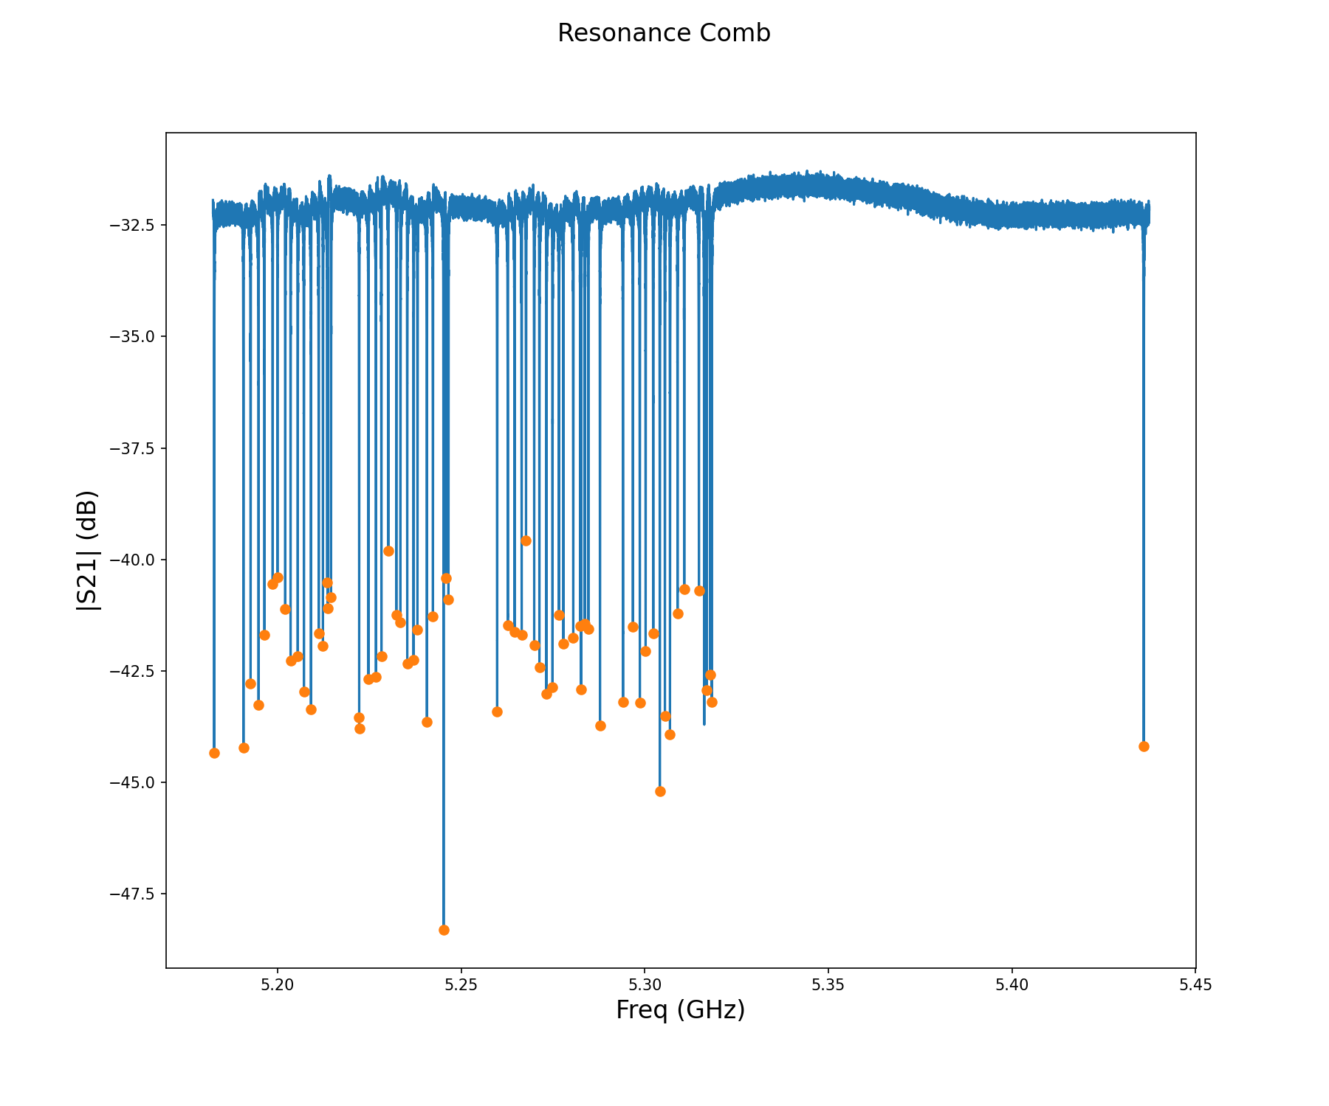
Resonance Comb (No flux ramp bias or simulated TES signal)

Slide 3
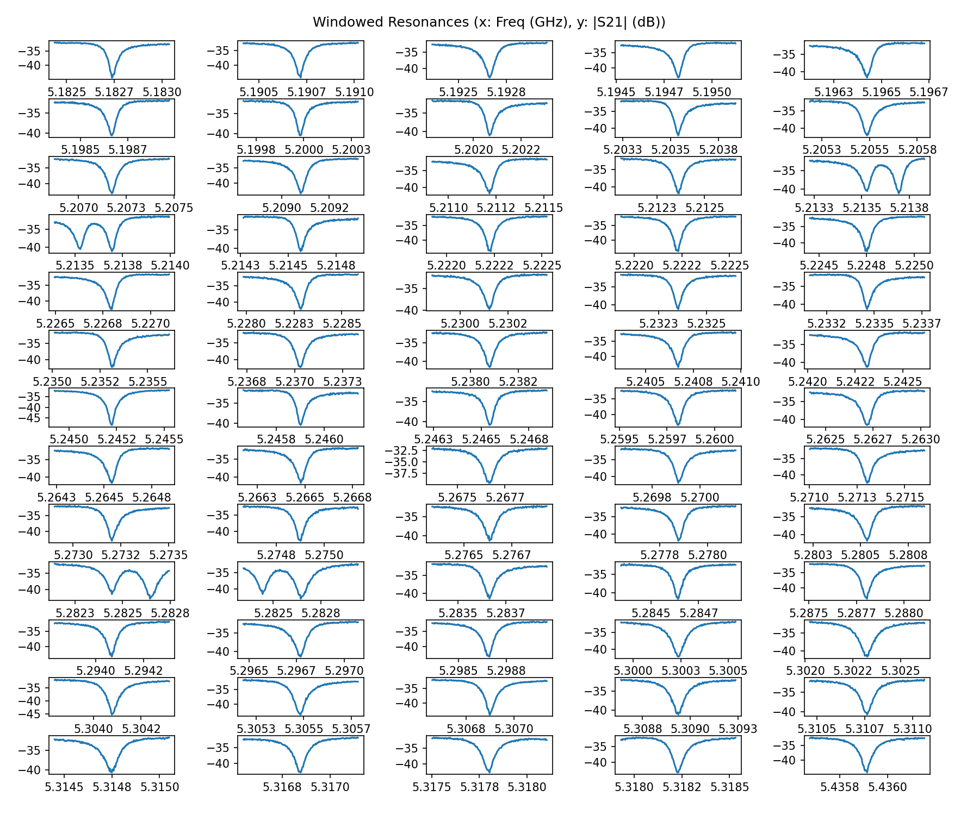
Windowed Resonances (No flux ramp bias or simulated TES signal)

Slide 4
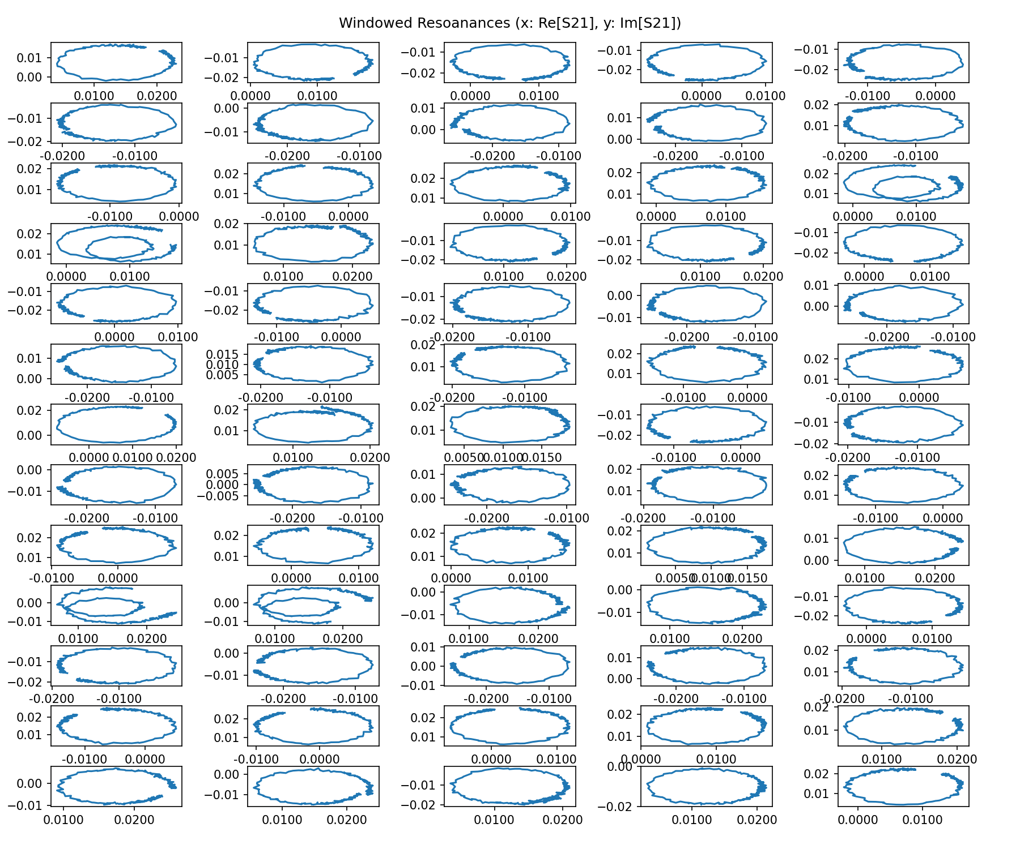
Windowed Resonances (No flux ramp bias or simulated TES signal)

Slide 5
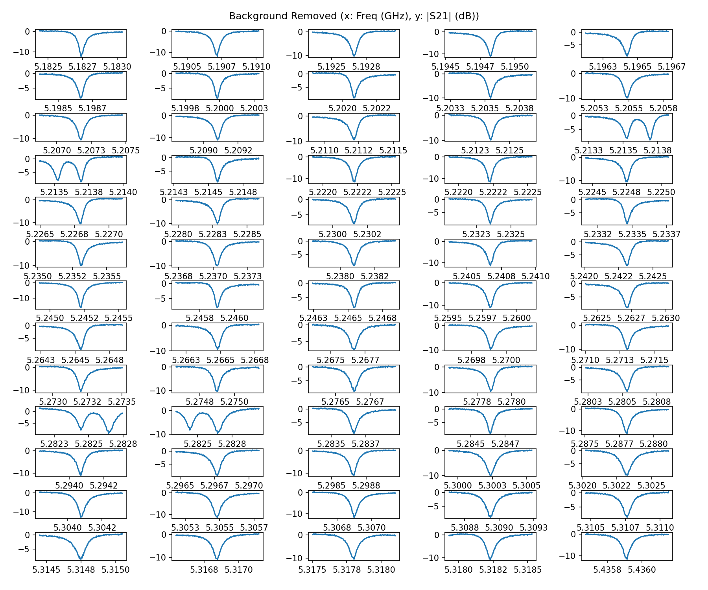
Background Removal (No flux ramp bias or simulated TES signal)

Slide 6
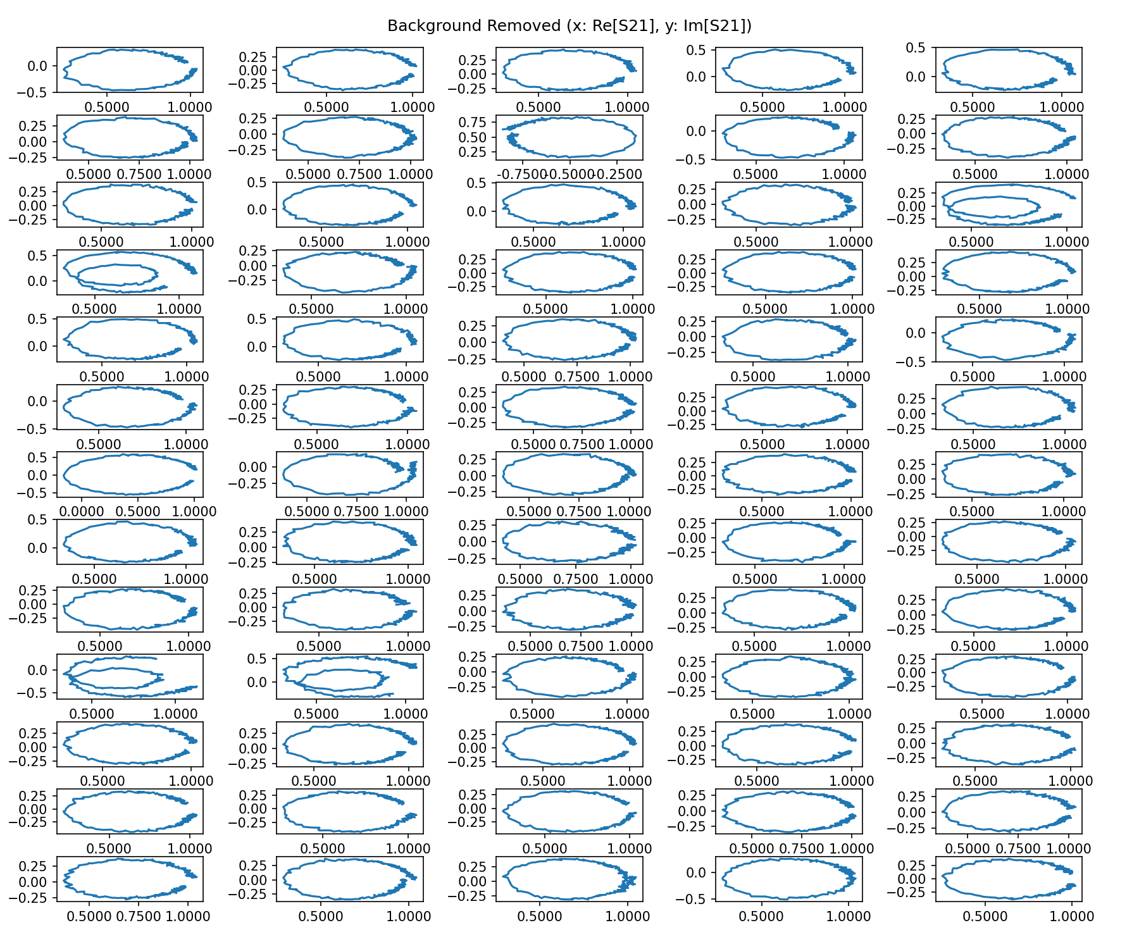
Background Removal (No flux ramp bias or simulated TES signal)

Slide 7
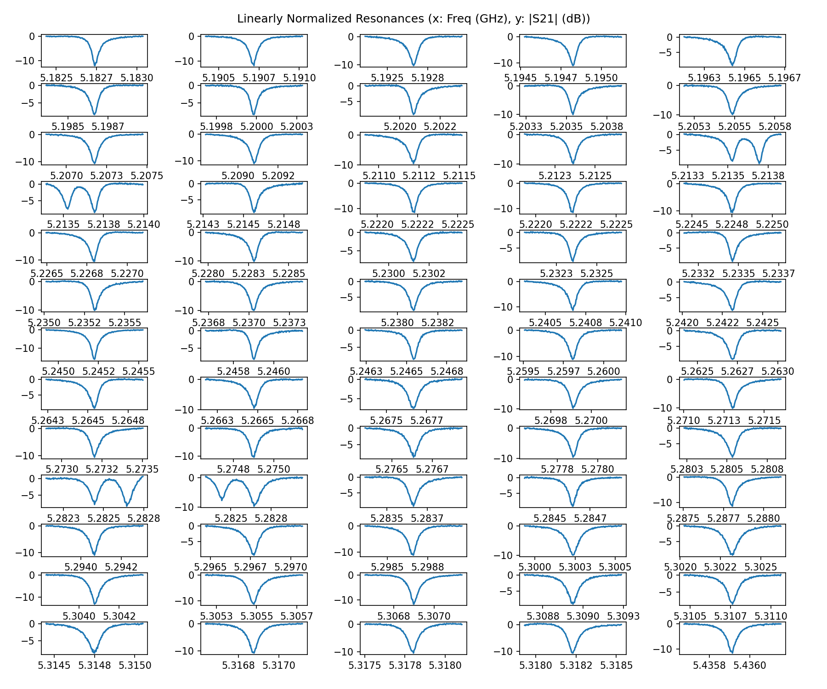
Linear Normalization (No flux ramp bias or simulated TES signal)

Slide 8
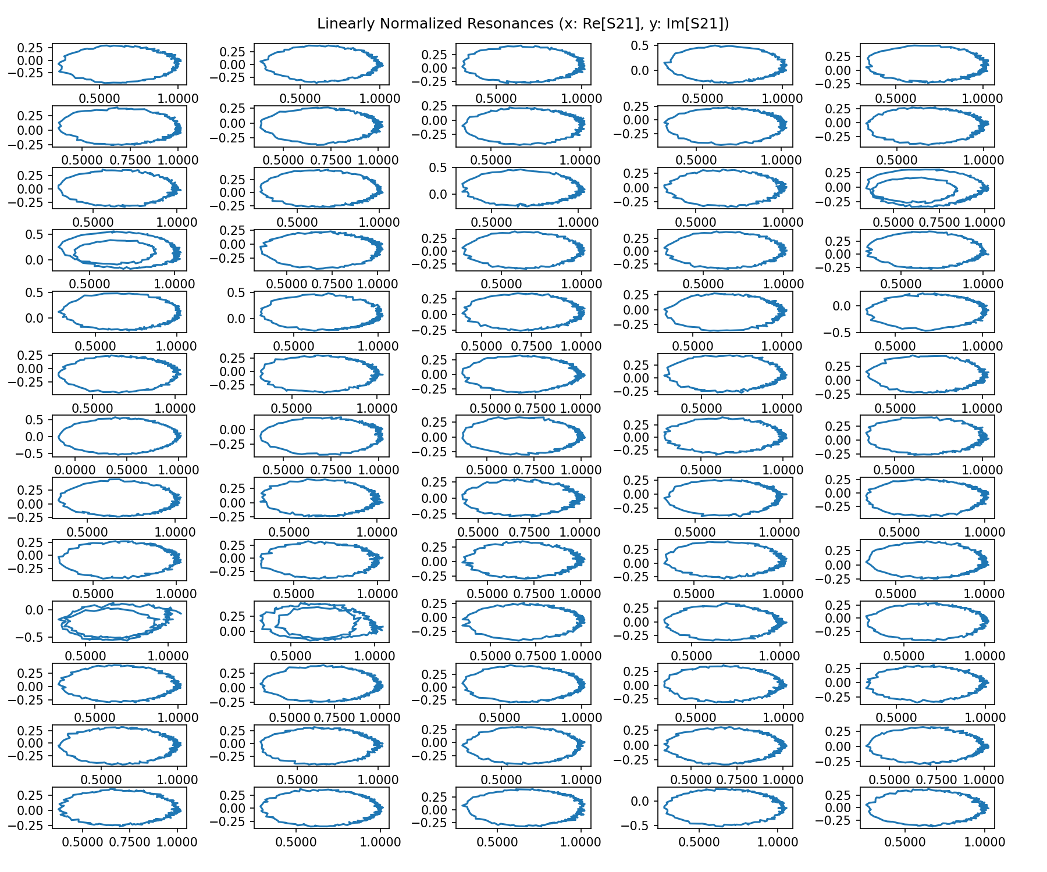
Linear Normalization (No flux ramp bias or simulated TES signal)

Slide 9
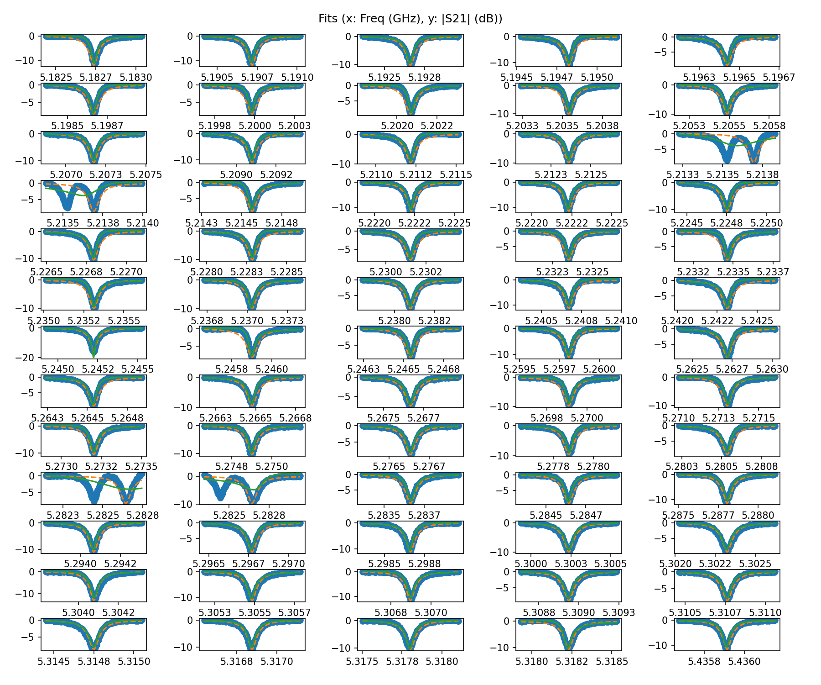
Fit (No flux ramp bias or simulated TES signal)
Blue = Data
Orange = Initial Fit
Green = Best Fit

Slide 10
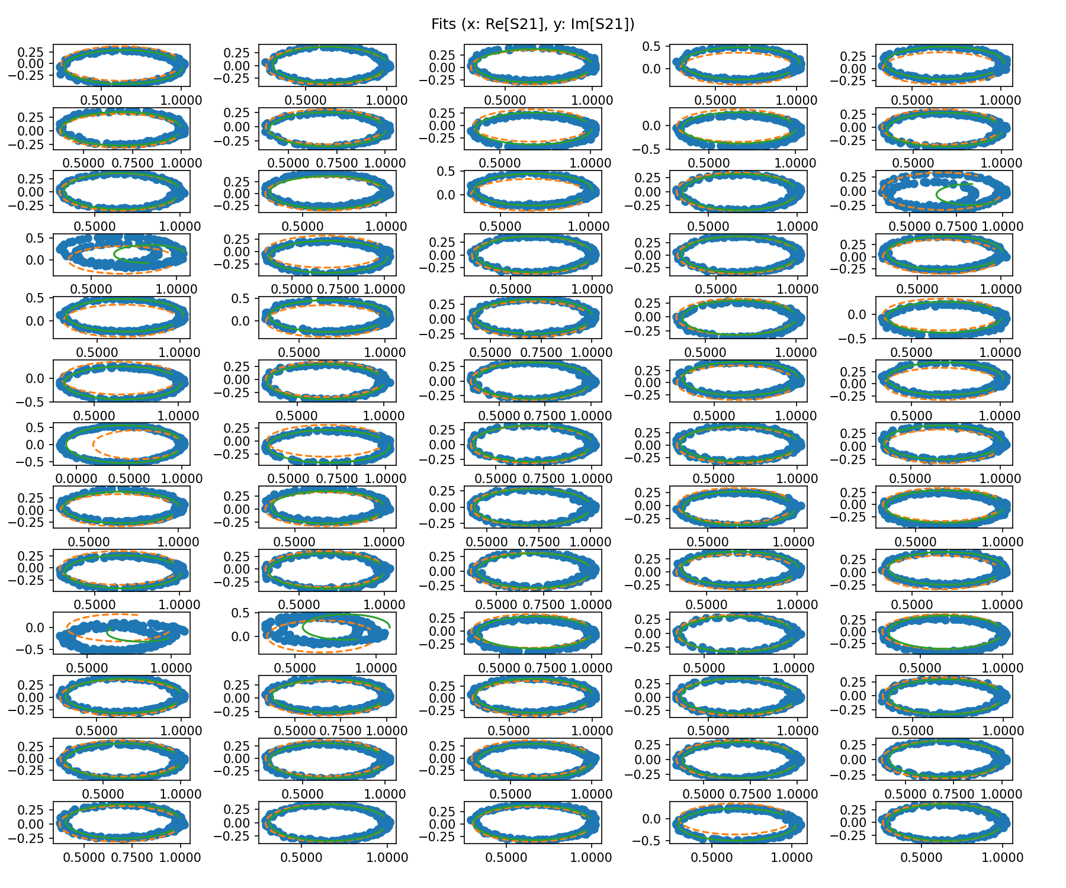
Fit (No flux ramp bias or simulated TES signal)
Blue = Data
Orange = Initial Fit
Green = Best Fit

Slide 11
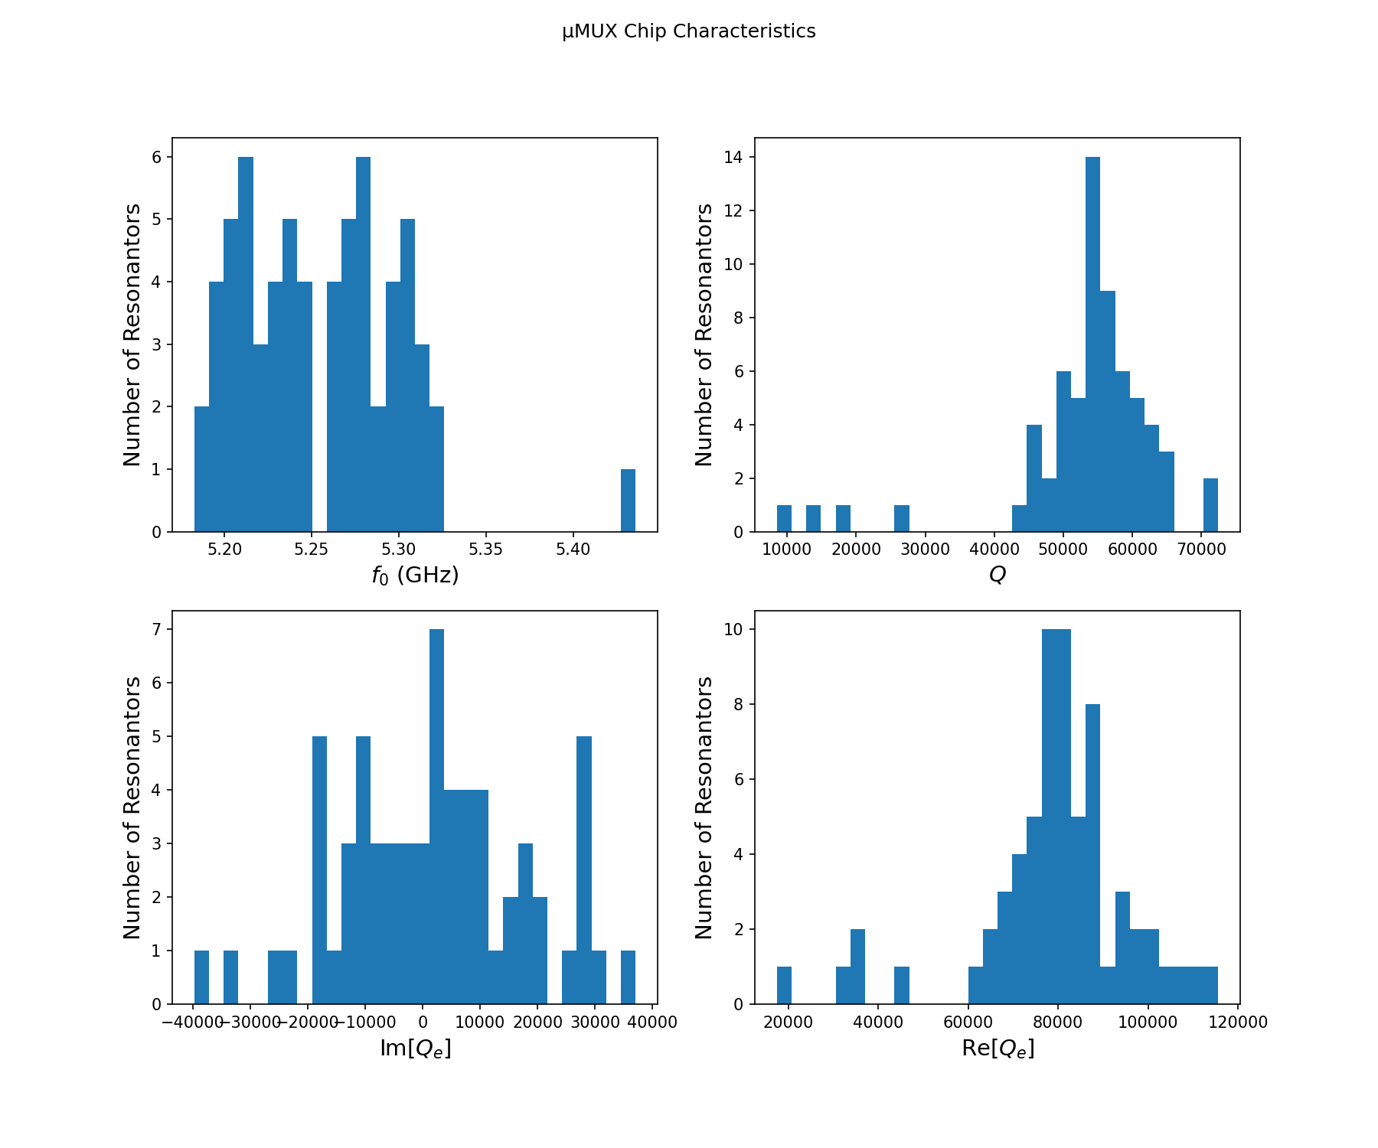
Fit Parameters (No flux ramp bias or simulated TES signal)

Slide 12
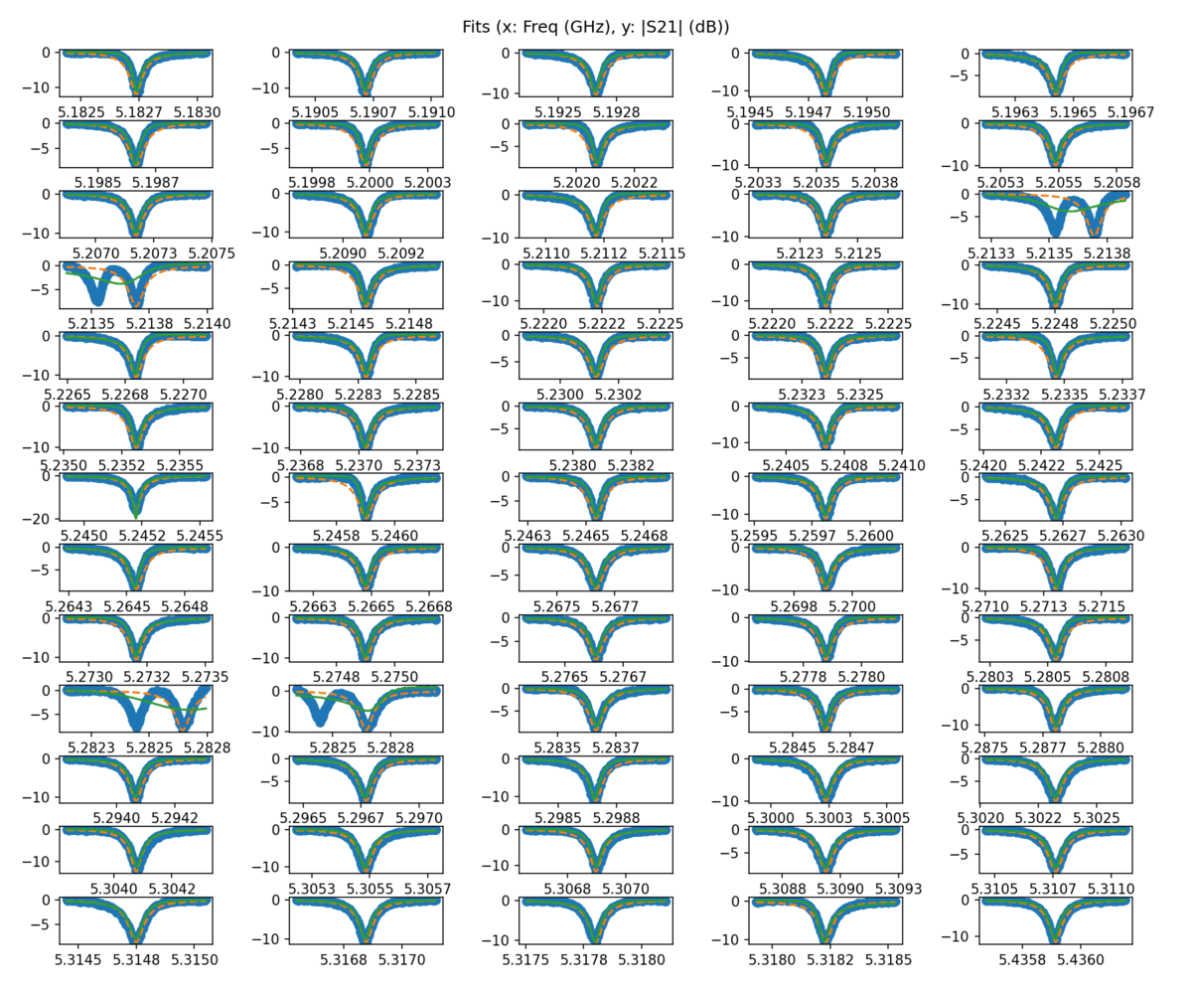
Fits with Voltage Applied to Flux Ramp Bias Line (across 1 Φ₀)
Observations:
Resonance 1 not connected to flux ramp bias line (by design)
A few resonances (e.g., 5, 27, 52, 53) move in the opposite direction under a bias on the flux ramp line (SQUID curves out of phase with other resonators)
Resonances 7 and 36 failed to fit near the maximum of their SQUID curve; SQUID curves exhibit non-periodic behavior
Overlap of resonances 14 and 15 and 45 and 45 make SQUID curve analysis difficult
Blue = Data
Orange = Initial Fit
Green = Best Fit

Slide 13
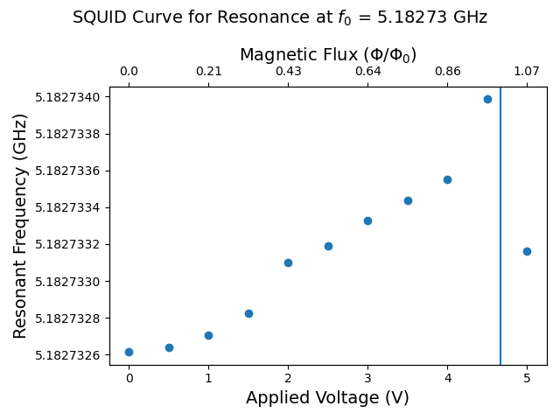
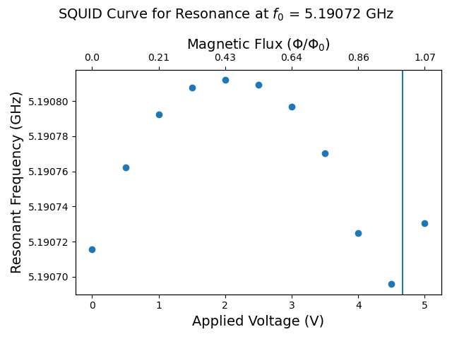
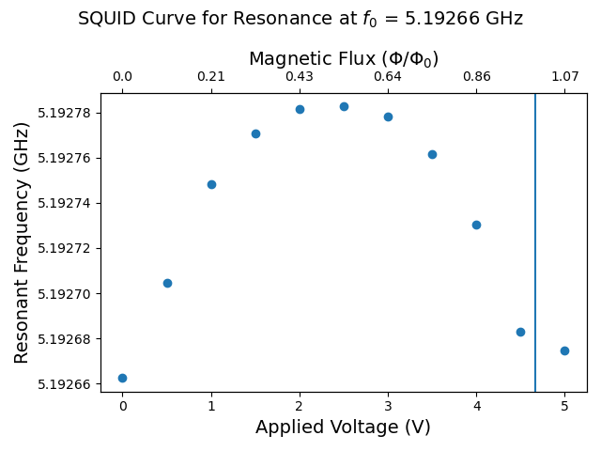
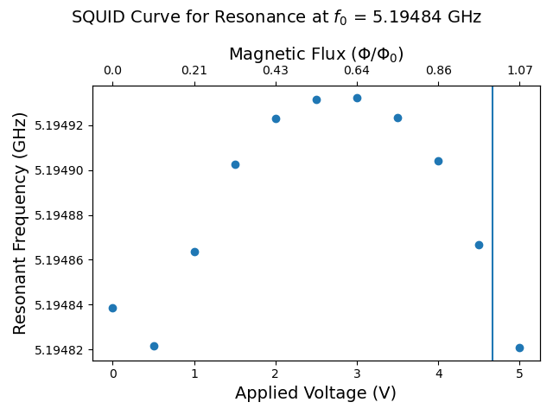
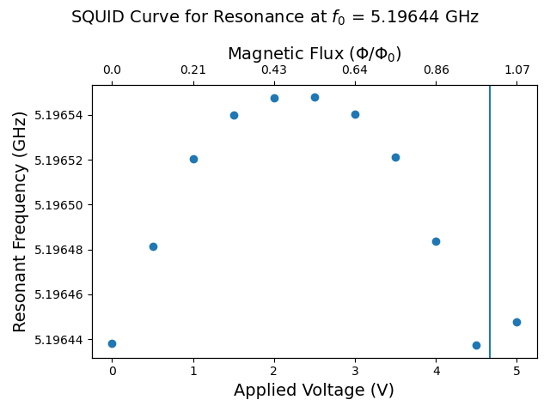
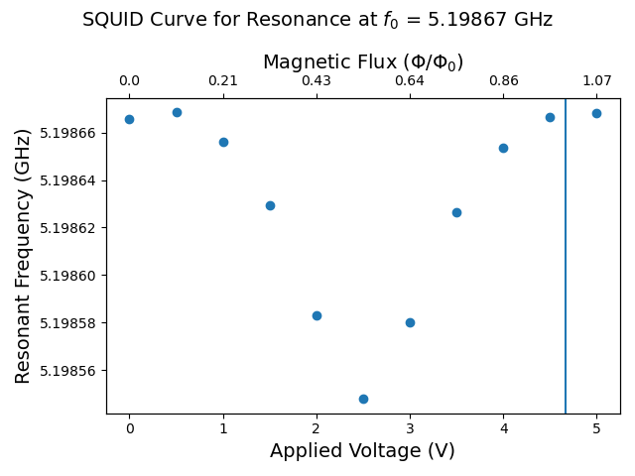
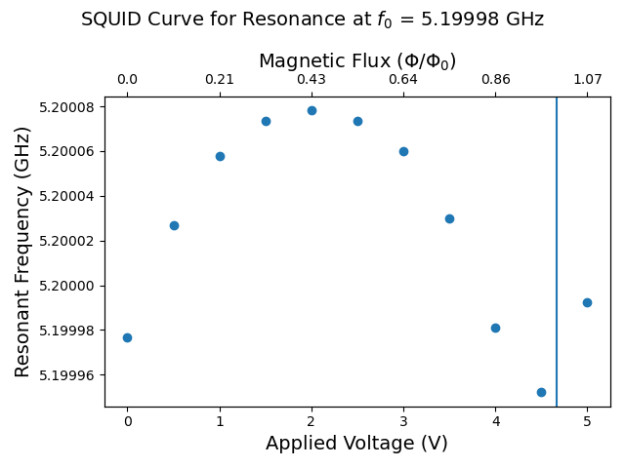
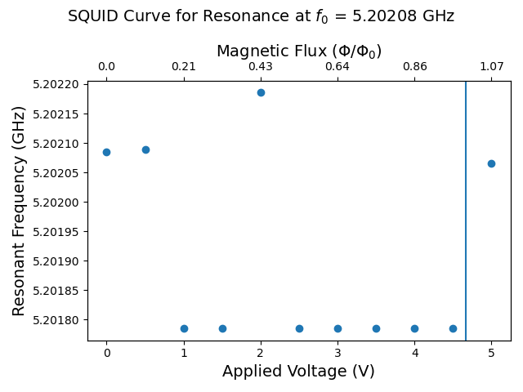
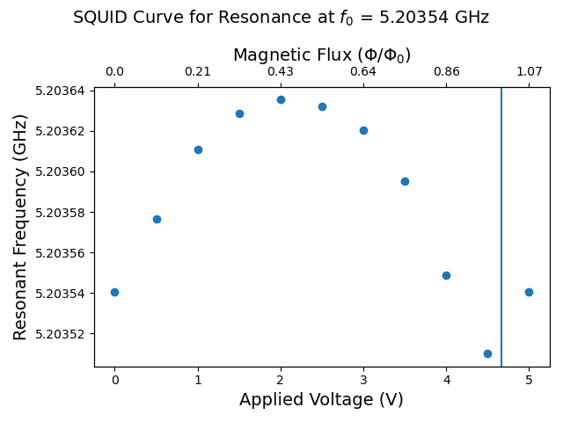
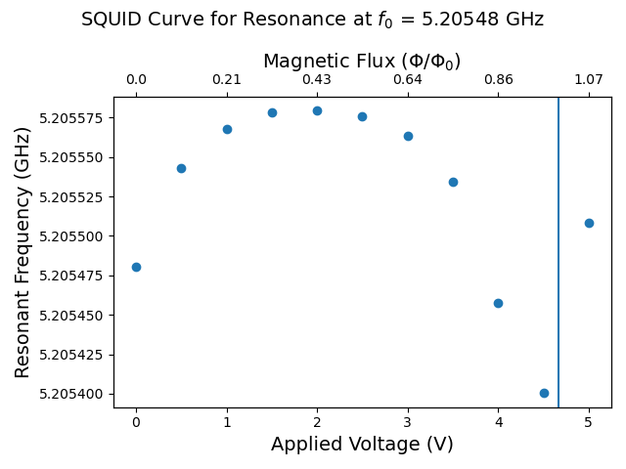
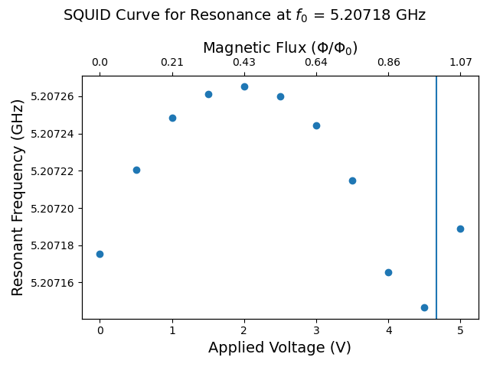
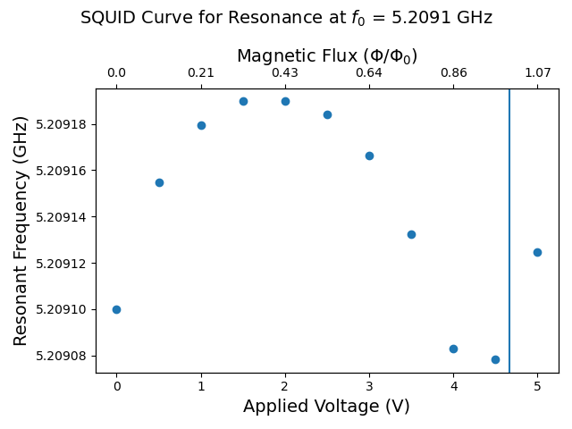
SQUID Curves with Voltage Applied to Flux Ramp Bias Line (across 1 Φ₀)

Slide 14
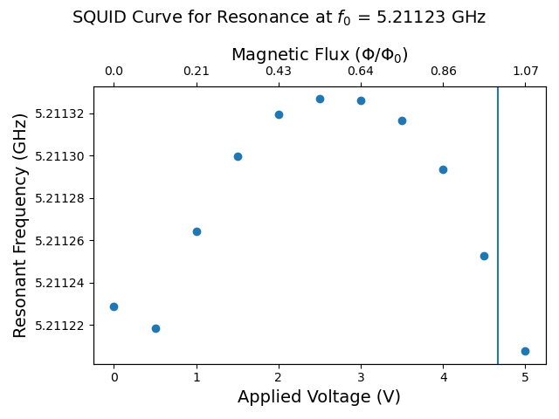
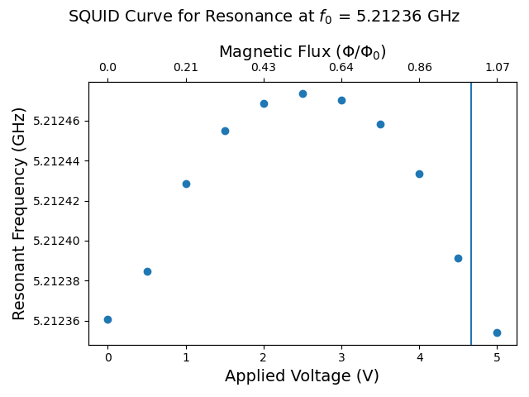
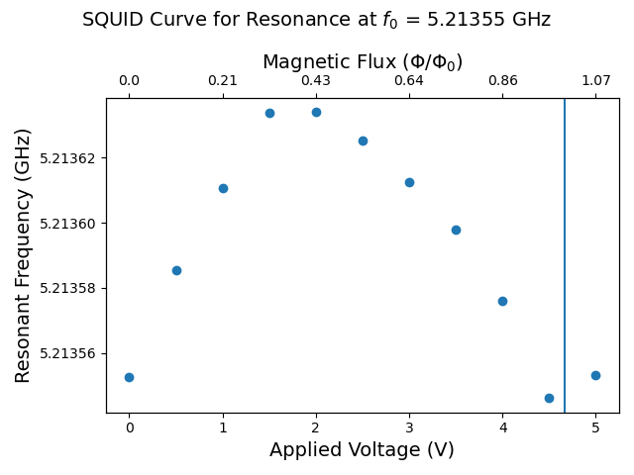
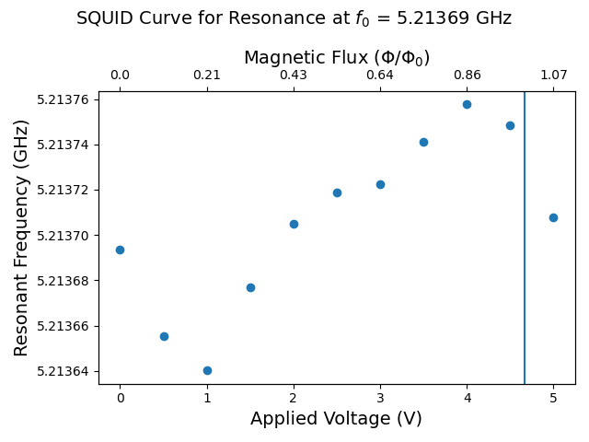
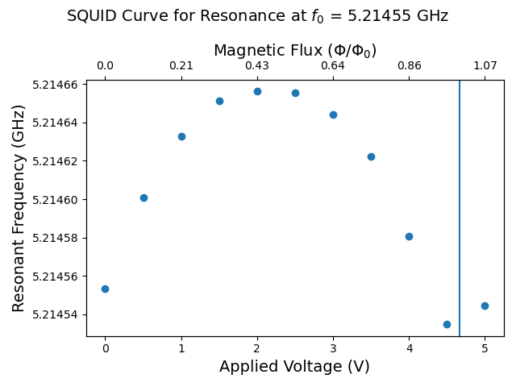
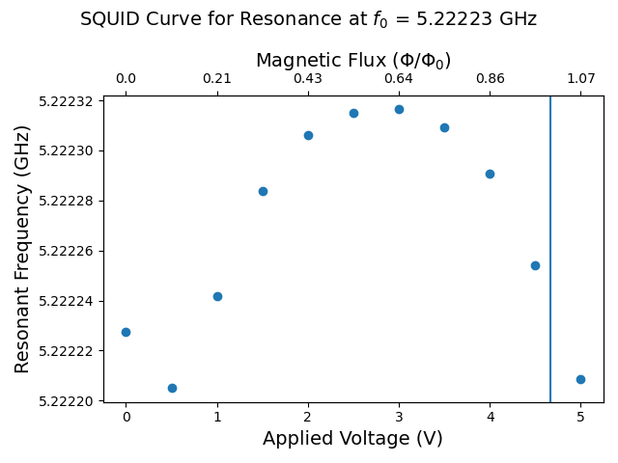

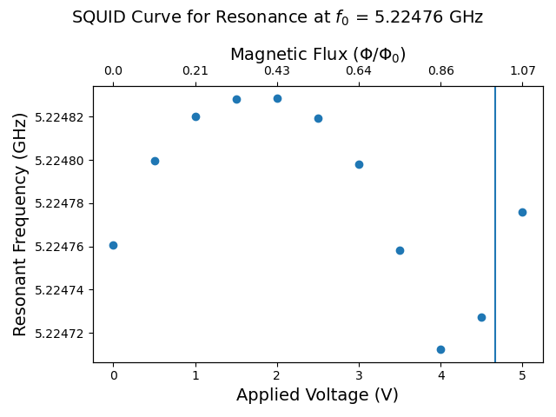
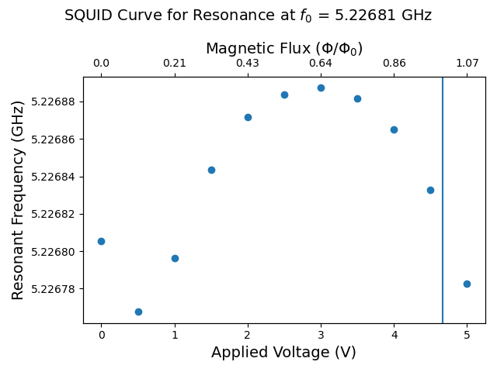
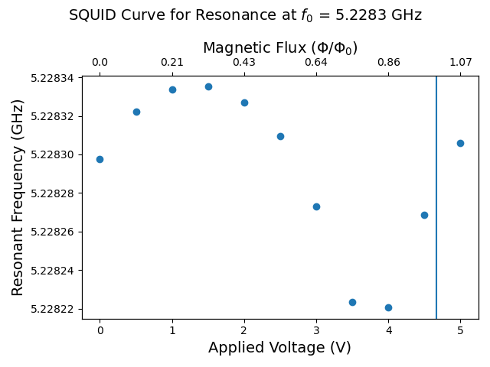

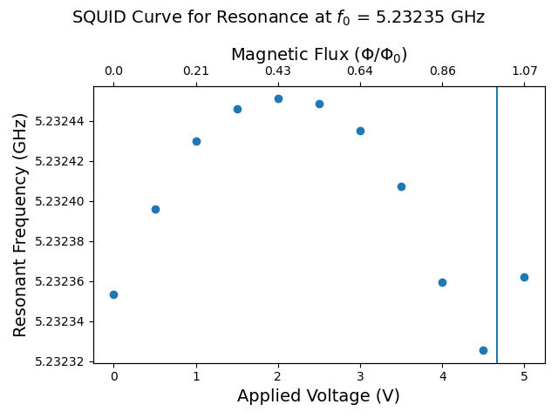
SQUID Curves with Voltage Applied to Flux Ramp Bias Line (across 1 Φ₀)

Slide 15
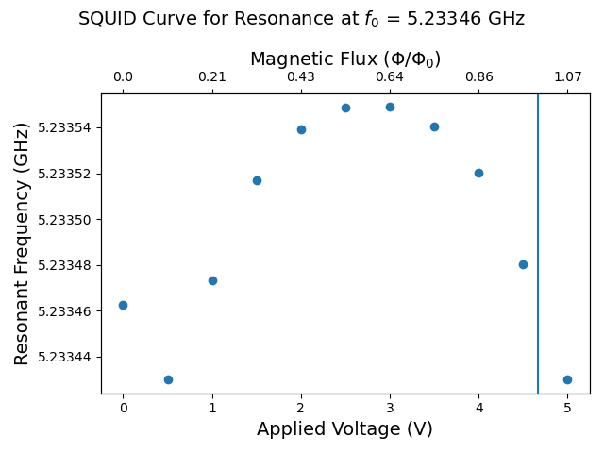
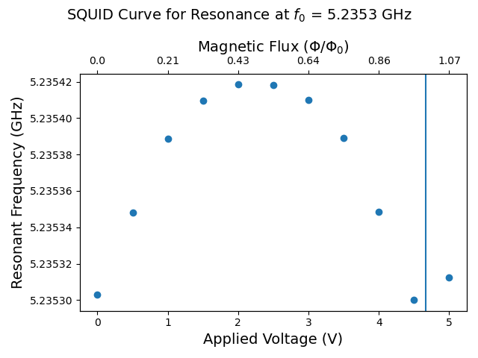



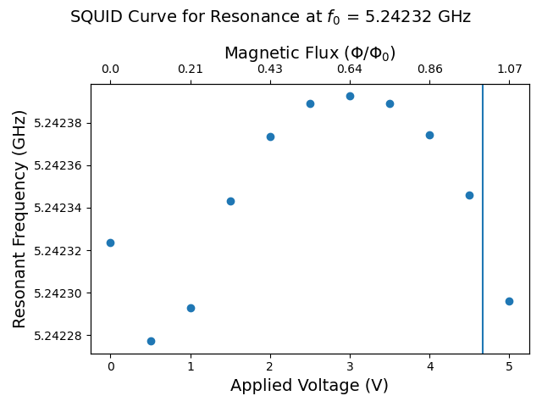
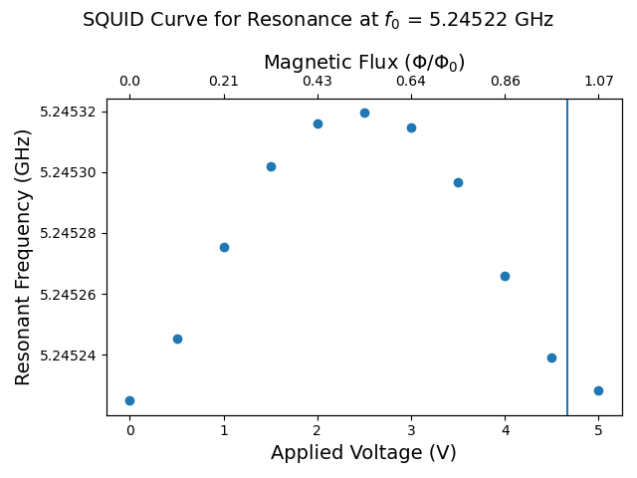


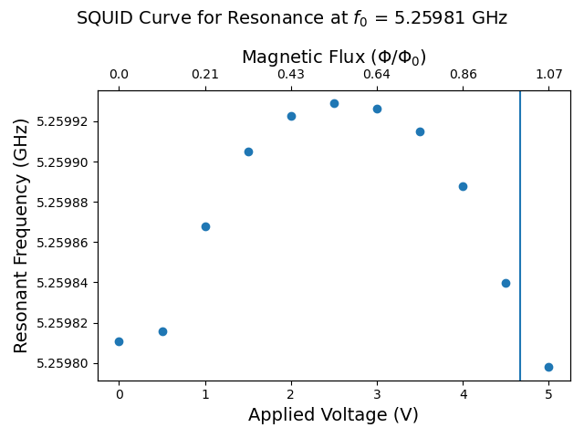

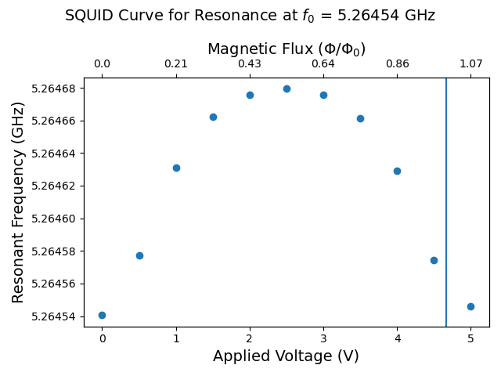
SQUID Curves with Voltage Applied to Flux Ramp Bias Line (across 1 Φ₀)

Slide 16
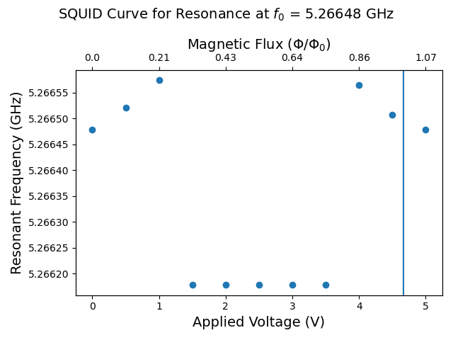
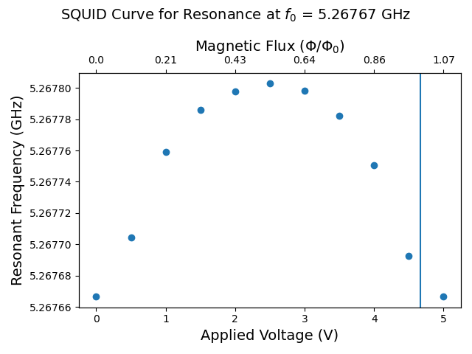
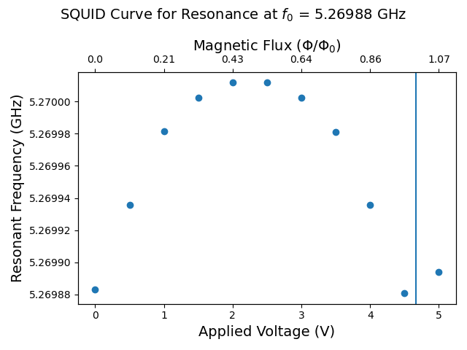

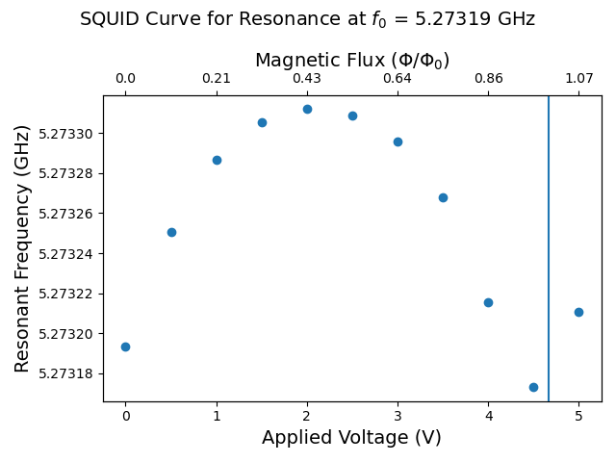

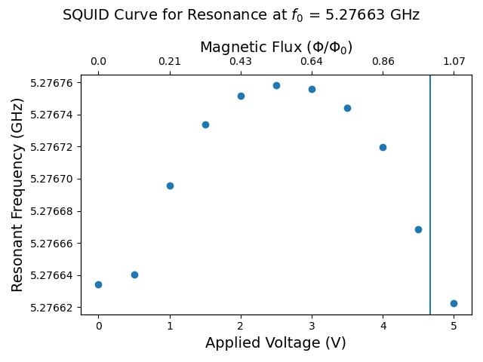

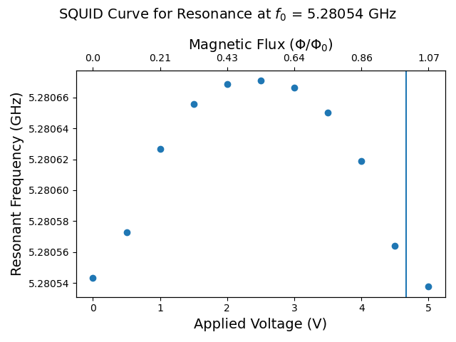
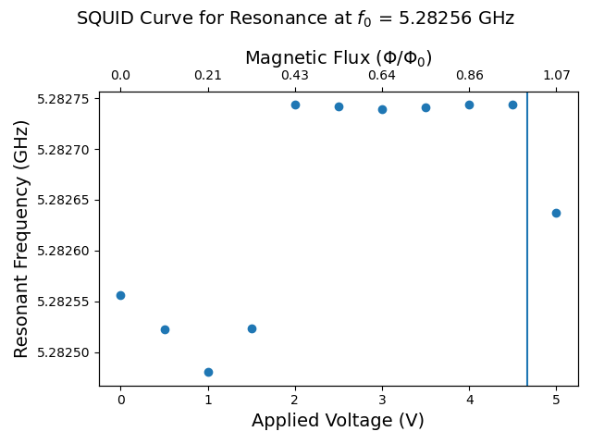
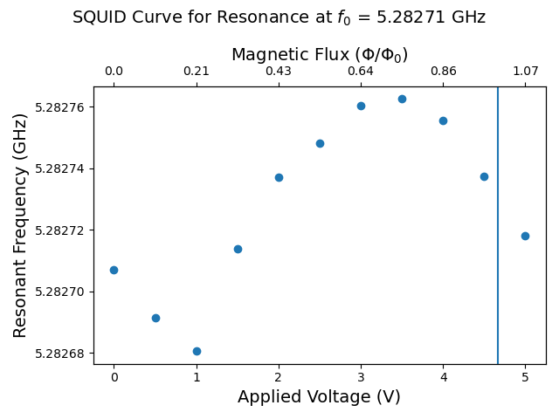
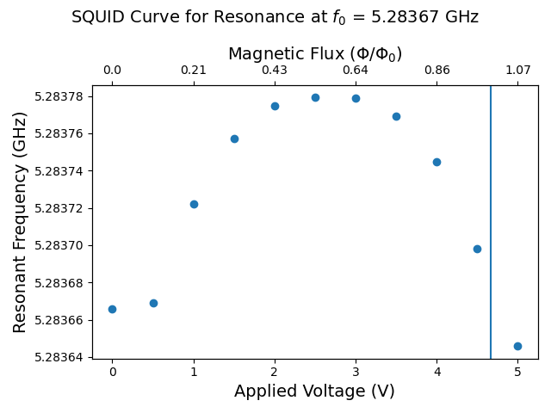
SQUID Curves with Voltage Applied to Flux Ramp Bias Line (across 1 Φ₀)

Slide 17

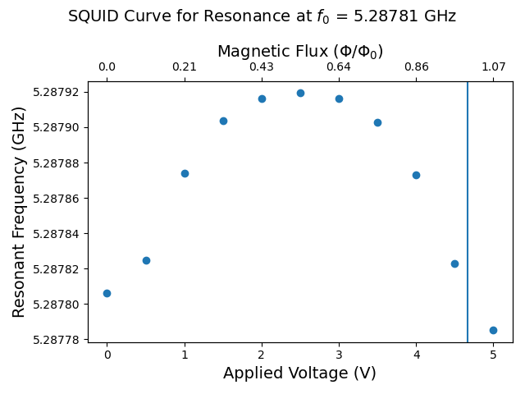
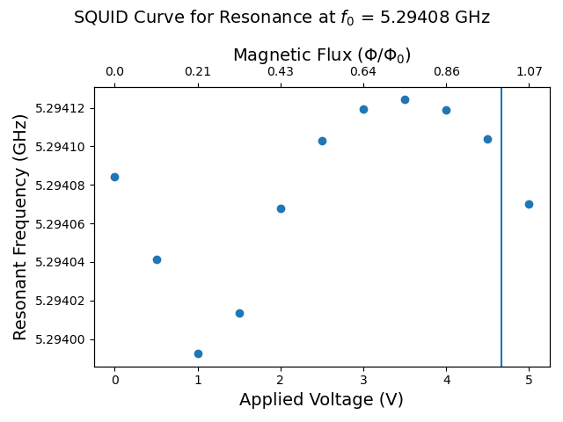









SQUID Curves with Voltage Applied to Flux Ramp Bias Line (across 1 Φ₀)

Slide 18





SQUID Curves with Voltage Applied to Flux Ramp Bias Line (across 1 Φ₀)

Slide 19

Fits with Voltage Applied to TES Input Line (across 1 Φ₀)
Observations:
No resonances seem to respond to current on the TES input line
Blue = Data
Orange = Initial Fit
Green = Best Fit

Slide 20



Selected Resistance for TES Input Line

